Slide 1
RFID BASED DOOR LOCK SYSTEM WITH MOBILE NOTIFICATION USING ARDUINO By
Mini-Project
PRESENTATION
ON
STUDENT NAME USN
SUMAN PAL 1NH17EC127
ANKIT KUMAR 1NH17EC007
P. R. SAI KARTHIK 1NH17EC135
JITENDER 1NH17EC035
Guided By
Dr Richard
Dept. of ECE
New Horizon College Of Engineering

Slide 2
INDEX
Introduction
Literature Survey
Aim and Objectives of Project
Top Level Block Diagram
Project Description
Progress Work
Milestones/Schedule
Outcome of Project
References

Slide 3
In today's modern world, security plays an important role.
Every person has precious accessories like gold, jewelry cash or important documents etc. .
It is not enough to have these accessories, but security of this is very important, for this purpose we keep them in bank lockers, secure rooms.
Still we often hear or read in newspaper that some fake person has access the locker of another person and have stolen money.
In order to overcome this type of frauds, authentication of the person who wants to use the locker is very important and to implement this purpose we are working on this project.

Slide 4
BASIC IDEA ABOUT THE TECHNOLOGY USED FOR THE PROJECT
RFID is a means of identifying a person or object using a radio frequency transmission. In other words RFID is an electronic method of exchanging data over radio frequency waves .
In the active RFID system, the reader sends signal to the tag using an antenna. The tag receives this information and resends this information along with the information in its memory. The reader receives this signal and transmits to the processor for further processing.
A GSM module or a GPRS module is a chip or circuit that will be used to establish communication between a mobile device or a computing machine and a GSM or GPRS system.
We are using Arduino Uno for our project to run the model using embedded c with Arduino IDE software.
Arduino Uno is a microcontroller board based on the ATmega328P (datasheet).

Slide 5
LITERATURE REVIEW
Paper No | Title | Author & Year of Publication | Outcome | Limitation
1. | RFID Security | Frank Thornton and Chris Lanthem | Coverage includes: security breaches for monetary gain, protection personal privacy and it discusses about the security purposes.
2. | RFID for Libraries: A Practical Guide | M. Paul Pandian | Concludes chapters look into the future to see what developments might be possible with RFID in libraries. | It does not tell about the privacy system of RFID
3. | Internet of Things with GSM Module . | Marco Schwartz | This book tells about all gsm AT commands in detail. | We did not find any cloud based connection here.

Slide 6
AIM AND OBJECTIVE
AIM: To make a RFID And Keypad Based Door Lock System With Mobile Notification Using Arduino and GSM Module.
OBJECTIVE:
The aim of the proposed system is to construct a secure access control system to control the entry of unknown people through a door or a passage using RFID technology.
Provide high locking security.
Our system can detect the theft and send message to users.
As mobile messaging or notification system is used here, so it will make the system more secure and the purpose of this is the person or the user can access the door in very secure way.

Slide 7
COMPONENTS USED:
PROJECT DESCRIPTION
Arduino Uno/Arduino Mega
EM-18(RFID reader module)
LEDS and Buzzer
I2C LCD DISPLAY
4*4 Keypad
Power supply (5v)
GSM Module
Servo Motor
RFID Tags
Bread Board
SOFTWARE USED:
Arduino IDE

Slide 8
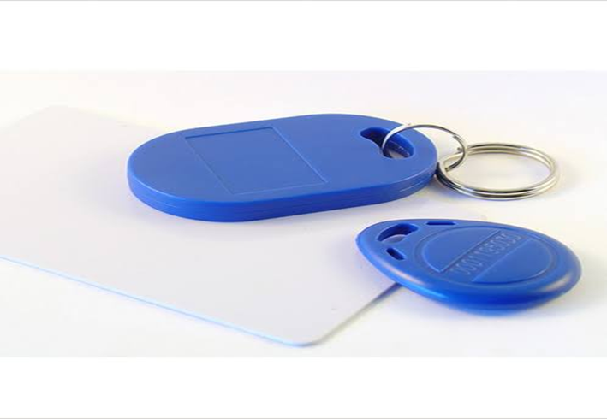
RFID TAGS:
HARDWARE DESCRIPTION
An RFID tag contains of a chip and antenna. A chip can store the unique s number or any other secure information based on the tag’s type of memory, which may be read-only, read-write, or write-once read-many.
The antenna that is attached to the microchip, sends information from the chip to the reader
Basically a larger antenna indicates a large read-write range. Each RFID tags has its own specific key value which can be used for security purposes.

Slide 9
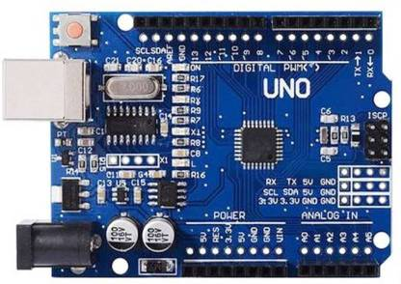
ARDUINO:
Microcontroller | ATmega328
Operating Voltage | 5V
Input Voltage (recommended) | 7 – 12V
Input Voltage (limits) | 6 – 20V
Digital I/O Pins | 14
Flash Memory | 32 KB (ATmega328)
SRAM | 2 KB (ATmega328)
Clock Speed | 16 MHz

Slide 10
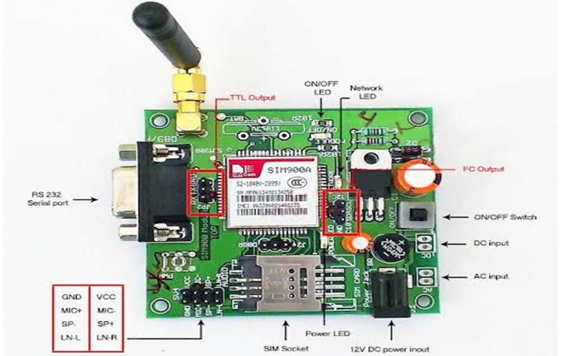
GSM MODULE:
The GSM/GPRS-compatible is Quad-band cell phone, which works on a frequency of 850/900/1800/1900MHz and which can be used not only to access the Internet, but also for oral communication (provided that it is connected to a microphone and a small loud speaker) and for SMSs.
Internally, the module is managed by an AMR926EJ-S processor, which controls phone communication, data communication (through an integrated TCP/IP stack), and (through an UART and a TTL serial interface) the communication with the circuit interfaced with the cell phone itself.

Slide 11
ARDUINO IDE:
SOFTWARWE DESCRIPTION
The Arduino Integrated Development Environment (IDE) is a cross-platform application (for Windows, macOS, Linux) that is written in the programming language Java. It is used to write and upload programs to Arduino compatible boards, but also, with the help of 3rd party cores, other vendor development boards.
The Arduino IDE supports the languages C and C++ using special rules of code structuring.
The Arduino IDE supplies a software library from the Wiring project, which provides many common input and output procedures.

Slide 12
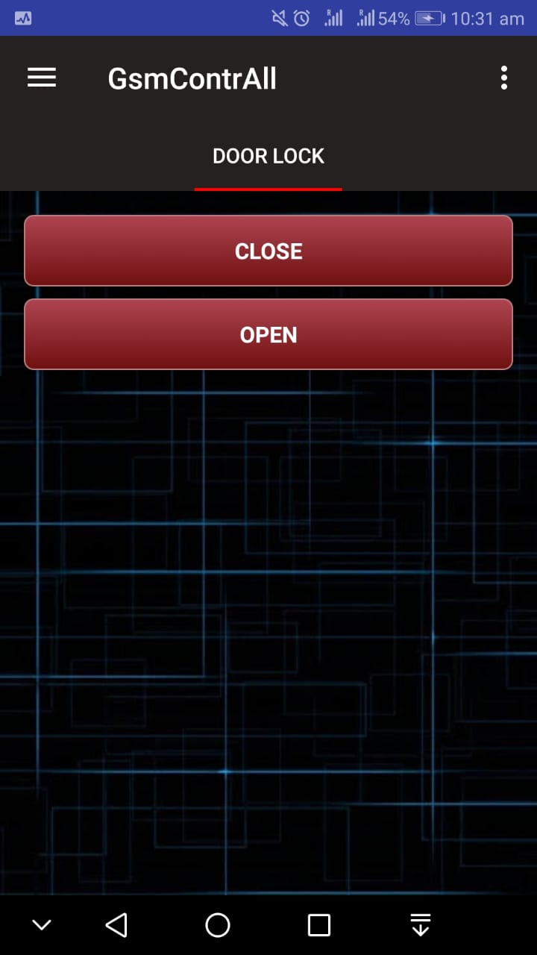
GSM CONTROLLER

Slide 13
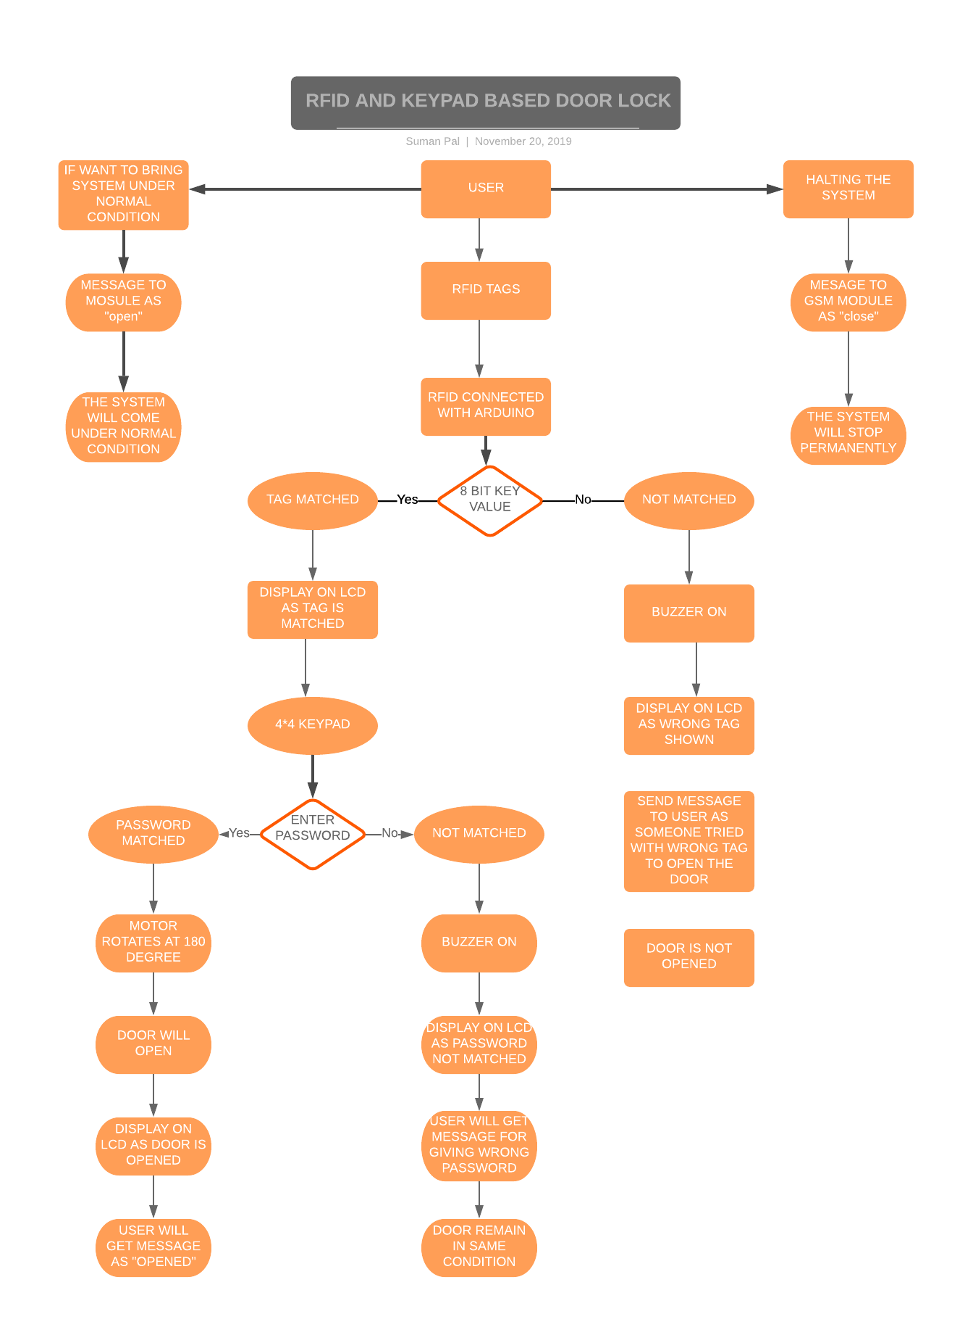
TOP LEVEL BLOCK DIAGAM
13

Slide 14
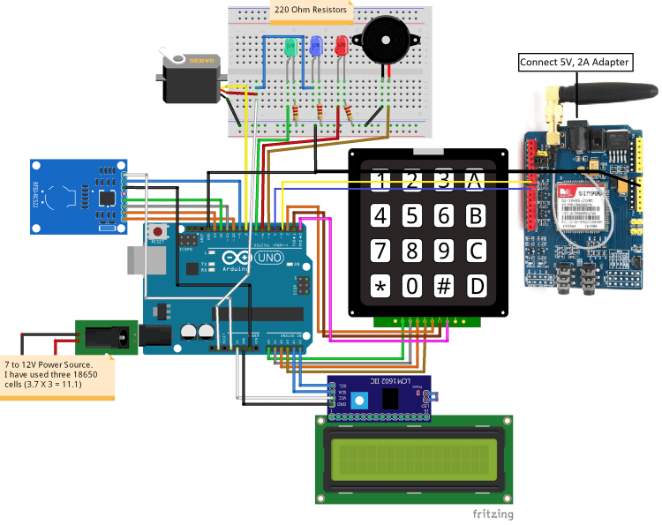
General picture of Circuit Connection

Slide 15
EXISTING METHOD
Manual locking system is the one of the existing methods which is widely used by the banking system.
It is insecure when the key was lost and manual interference.
One more conventional methods is digital locking system it is also insecure if any one hacks the password.

Slide 16
PROPOSED METHOD
We are using the Sim900 GSM module in that system to make it an RFID and Keypad based Door lock and alert system using Arduino.
On scanning the wrong tag or on entering the wrong password, it will send us an alert.
When the user scan the right tag and enter the right password, it will send us a confirmation message that the door has opened.
You can halt the system by sending ‘close’ message to Arduino and it will only go back to normal mode when you will send the ‘open’ message to Arduino. During halt time, it won’t scan any tags and it will only look for messages.
You can also open the door by sending message to Arduino.

Slide 17
Project Work Distribution
Name of Team Member | Work distributed
Suman Pal | Model and GSM module connection
Ankit Kumar | Model and Report
Jitendr | Components and Aruduino IDE coding
Sai Karthik PR | Coding of RFID part and report

Slide 18
OUTCOME OF PROJECT
The door locking system functions in real time as when the user put the tag in contact with the reader, the motor starts rotating and the door opens.
We utilize RFID technology to provide solution for secure access of a door or any private room of any owner.
We will be able to open the door by RFID tag and keypad using RFID sensor.
On scanning the right tag and on entering the right password, it will send us a confirmation message that the door has opened.
When the motor starts rotating at 180 degree the door will open and after 5 seconds of delay the door will automatically close and we will get our desired output.
18

Slide 19
ADVANTAGES
Provide high security.
No need to remember username.
Easy to use.
Fully automatic system
Dual layer security with RFID card and notification option.
Theft protection and alert.

Slide 20
APPLICATIONS
Home security system
bank locker system
secure some important section in industries.
For used in identification.
secured offices
All that places when unique identity & high security is required.

Slide 21
CONCLUSION
Thus it is a real time embedded system providing security to smart lockers and like systems. As the system consists of components like GSM ,Arduino, so system is cost effective and easy to handle. Thus this system is an ideal way of securing door Locks.

Slide 22
REFERENCES
[1] Zeydin Pala and Nihat Inan, “Smart parking application using RFID technology”, RFID Eurasia, 1st Annual in RFID Eurasia, 2007.
[2] Zhang, L., “An Improved Approach to Security and Privacy of RFID application System”, Wireless Communications, Networking and Mobile Computing. International Conference. pp 1195- 1198, 2005.
[3] Xiao, Y., Yu, S., Wu, K., Ni, Q., Janecek., C., Nordstad, J,” Radio frequency identification: technologies, applications, and research issues” Wiley Journal of Wireless Communications and Mobile Computing, Vol 7, May 2007.
[4] Goodrum, P., McLaren, M., Durfee, A.,” The application of active radio frequency identification technology for tool tracking on construction job sites.” Automation in Construction, 15 (3), 2006, pp 292-302.

Slide 23


